Slide 1
Java Design Patterns
Most useful JDP and some variances

Slide 2
Categorization
Creational | Structural | Behavioral
Factory Pattern | Adapter Pattern | Chain Of Responsibility Pattern
Abstract Factory Pattern | Bridge Pattern | Command Pattern
Singleton Pattern | Composite Pattern | Interpreter Pattern
Prototype Pattern | Decorator Pattern | Iterator Pattern
Builder Pattern | Facade Pattern | Mediator Pattern
 | Flyweight Pattern | Memento Pattern
 | Proxy Pattern | Observer Pattern
 |  | State Pattern
 |  | Strategy Pattern
 |  | Template Pattern
 |  | Visitor Pattern

Slide 3
Categorization
Creational | Structural | Behavioral
Factory Pattern | Adapter Pattern | Command Pattern
Abstract Factory Pattern | Decorator Pattern | Mediator Pattern
Singleton Pattern | Flyweight Pattern | Observer Pattern
Builder Pattern |  | Strategy Pattern

Slide 4
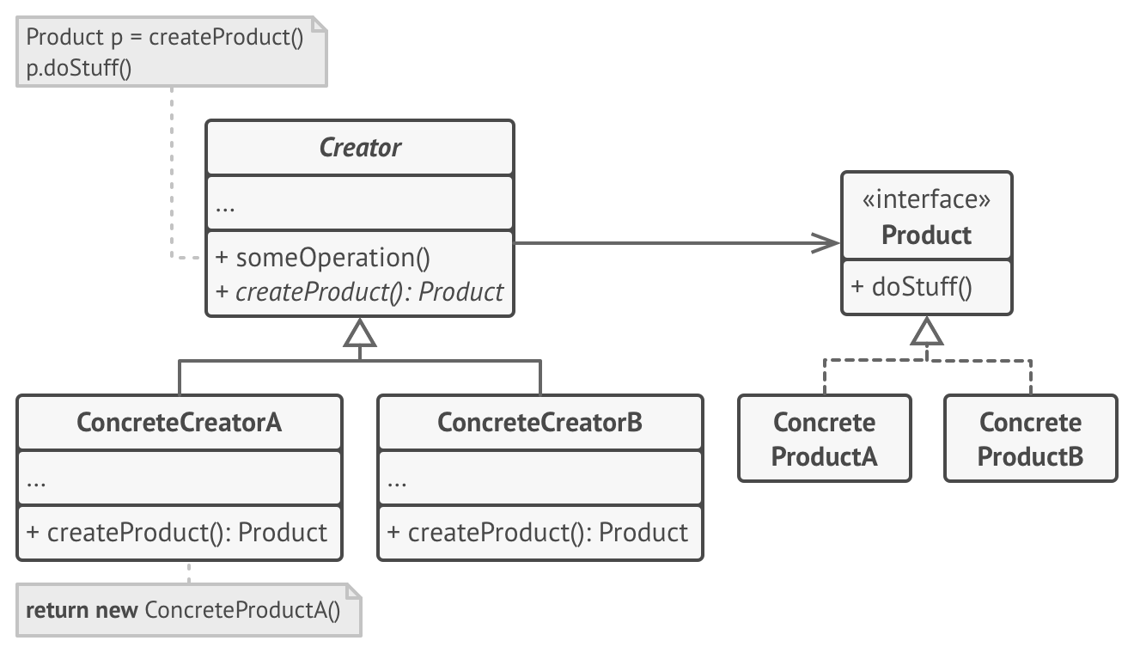
Factory design pattern
It is most suitable when complex object creation steps are involved. To ensure that these steps are centralized and not exposed to composing classes.

Slide 5
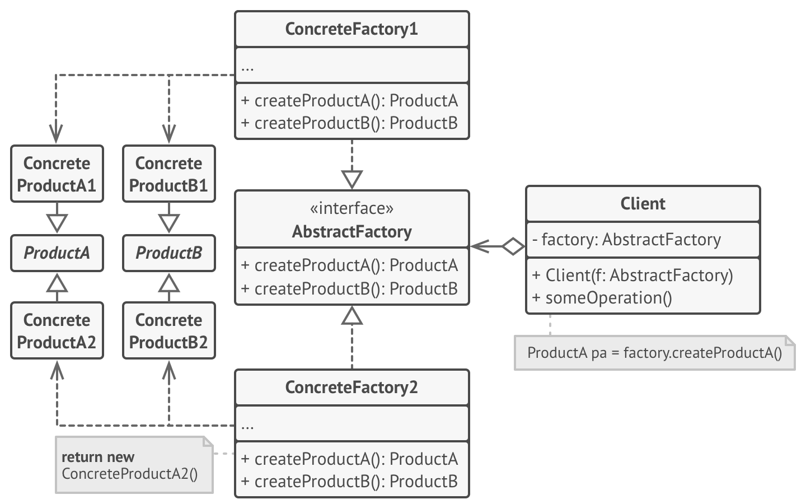
Abstract factory design pattern
Abstract factory pattern is used whenever we need another level of abstraction over a group of factories created using factory pattern.

Slide 6
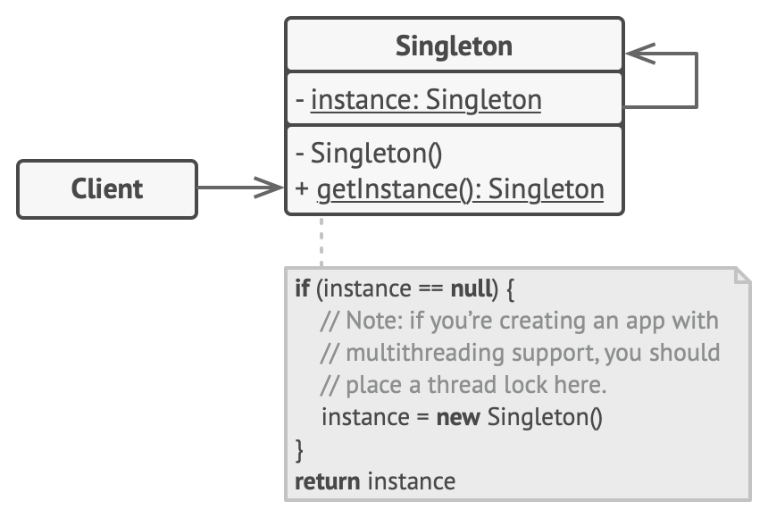
Singleton design pattern
It’s a design solution where an application wants to have one and only one instance of any class, in all possible scenarios without any exceptional condition.

Slide 7
Singleton design pattern
Eager initialization
Using static block
Lazy initialization
Thread safe singleton

Slide 8
Singleton design pattern
Eager initialization: This is a design pattern where an instance of a class is created much before it is actually required. Mostly it is done on system startup. In an eager initialization singleton pattern, the singleton instance is created irrespective of whether any other class actually asked for its instance or not.

Slide 9
Singleton design pattern
Using a static block: This is a sub part of Eager initialization. The only difference is object is created in a static block so that we can have access on its creation, like exception handling. In this way also, object is created at the time of class loading.

Slide 10
Singleton design pattern
Lazy initialization: It’s the tactic of delaying the creation of an object, the calculation of a value, or some other expensive process, until the first time it is needed. In a singleton pattern, it restricts the creation of the instance until it is requested for first time.

Slide 11
Singleton design pattern
Thread safe singleton: A thread safe singleton is created so that singleton property is maintained even in multithreaded environment.

Slide 12
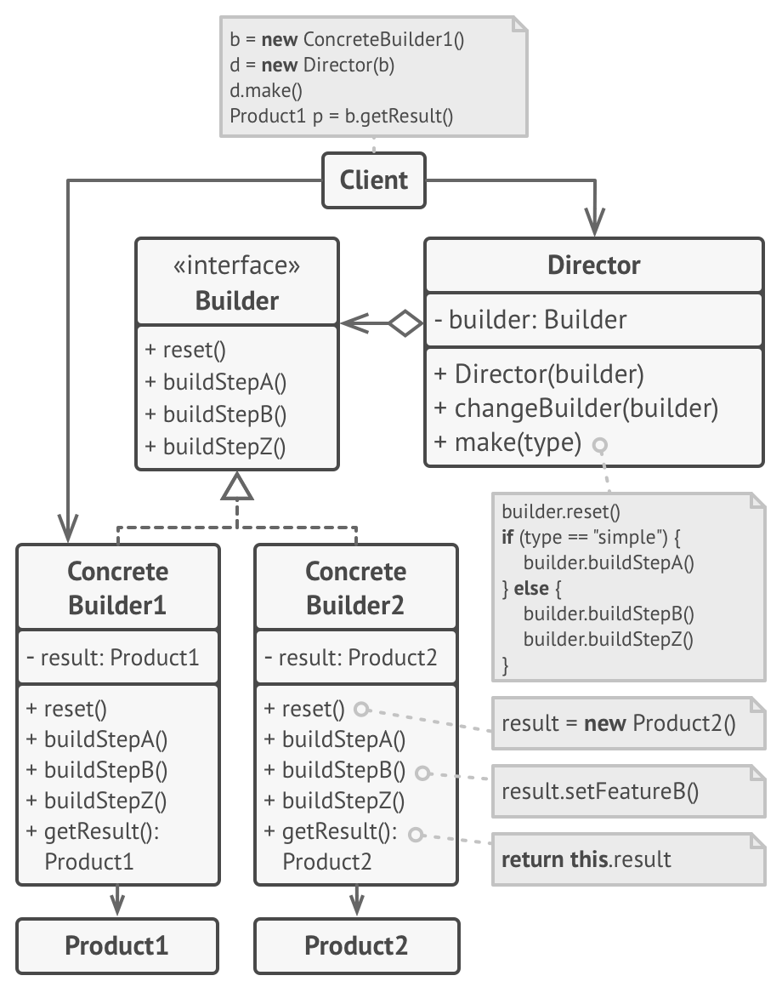
Builder design pattern
It’s an alternative way to construct complex objects. This should be used only when you want to build different immutable objects using same object building process.

Slide 13
Step Builder design pattern
It’s an extension of the builder pattern that fully guides the user through the creation of the object with no chances of confusion. The intent of the Step Builder design pattern is to separate the construction of a complex object from its representation by creating defined steps and exposing to the user only selected methods per time.

